Slide 1

Chapter 7 Pointers and C-Strings

Slide 2
Objectives
To describe what a pointer is (§7.1).
To learn how to declare a pointer and assign a value to it (§7.2).
To access elements via pointers (§7.2).
To pass arguments by reference with pointers (§7.3).
To understand the relationship between arrays and pointers (§7.4).
To know how to access array elements using pointers (§7.5).
To declare constant pointers and constant data (§7.5).
To learn how to return pointers from functions (§7.6).
To use the new operator to allocate persistent memory dynamically (§7.7).
To test and convert characters using the character functions (§7.9.1).
To store and access strings using arrays and pointers (§7.9.2).
To read strings from the keyboard (§7.9.3).
To process strings using the string functions (§7.9.4).

Slide 3
What is a Pointer?
Pointer variables, simply called pointers, are designed to hold memory addresses as their values. Normally, a variable contains a specific value, e.g., an integer, a floating-point value, and a character. However, a pointer contains the memory address of a variable that in turn contains a specific value.
So, pointer means address.
Notes:
Pointer just exists in C++ programming languages.

Slide 4
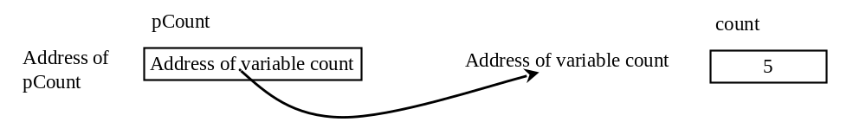
Declare a Pointer
Like any other variables, pointers must be declared before they can be used. To declare a pointer, use the following syntax:
dataType *pVarName;
Each variable being declared as a pointer must be preceded by an asterisk (*). For example, the following statement declares a pointer variable named pCount that can point to an int varaible.
int *pCount;
TestPointer

Slide 5
Dereferencing
Referencing a value through a pointer is called indirection. The syntax for referencing a value from a pointer is
*pointer
For example, you can increase count using
count++; // direct reference
or
(*pCount)++; // indirect reference

Slide 6
Pointer Type
A pointer variable is declared with a type such as int, double, etc. You have to assign the address of the variable of the same type. It is a syntax error if the type of the variable does not match the type of the pointer. For example, the following code is wrong.
int area = 1;
double *pArea = &area; // Wrong

Slide 7
Initializing Pointer
Like a local variable, a local pointer is assigned an arbitrary value if you don’t initialize it. A pointer may be initialized to 0, which is a special value for a pointer to indicate that the pointer points to nothing. You should always initialize pointers to prevent errors. Dereferencing a pointer that is not initialized could cause fatal runtime error or it could accidentally modify important data.

Slide 8
Caution
You can declare two variables on the same line. For example, the following line declares two int variables:
int i = 0, j = 1;
Can you declare two pointer variables on the same line as follows?
int* pI, pJ;
No, this line is equivalent to
int *pI, pJ;

Slide 9
Passing Arguments by Reference with Pointers
There are three ways to pass arguments to a function in C++: pass by value, pass by reference with reference arguments, and pass by reference with pointers.
TestPointerArgument

Slide 10
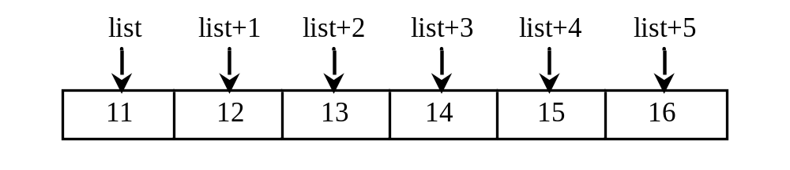
Arrays and Pointers
Recall that an array variable without a bracket and a subscript actually represents the starting address of the array. In this sense, an array variable is essentially a pointer. Suppose you declare an array of int value as follows:
int list[6] = {11, 12, 13, 14, 15, 16};

Slide 11
Array Pointer
*(list + 1) is different from *list + 1. The dereference operator (*) has precedence over +. So, *list + 1 adds 1 to the value of the first element in the array, while *(list + 1) dereference the element at address (list + 1) in the array.
ArrayPointer
PointerWithIndex
Notes:
Dereference 取值 * asterisk

Slide 12
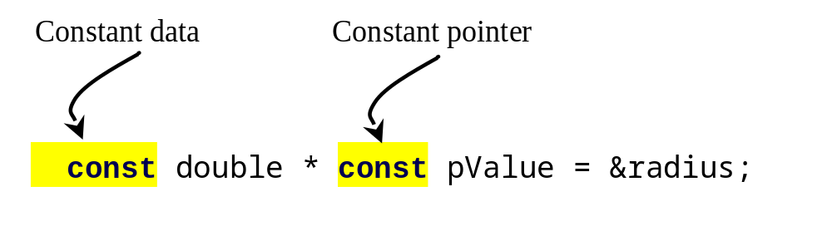
Using const with Pointers
You learned how to declare a constant using the const keyword. A constant cannot be changed once it is declared. You can declare a constant pointer. For example, see the following code:
double radius = 5;
double * const pValue = &radius;
ConstParameter

Slide 13
Returning Pointers from Functions
You can use pointers as parameters in a function. Can you return a pointer from a function? The answer is yes.
WrongReverse
CorrectReverse

Slide 14
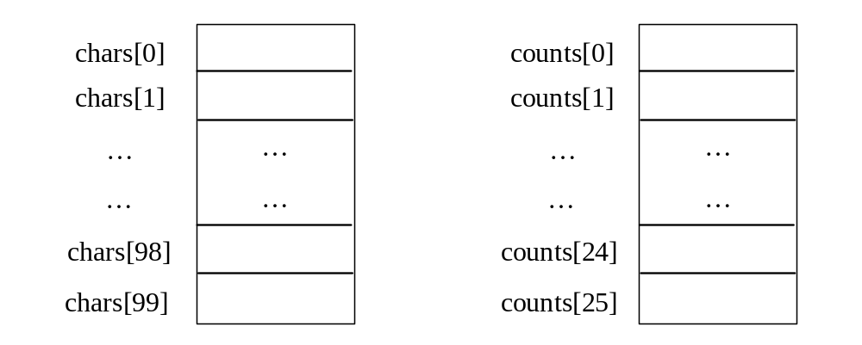
Case Studies: Counting the Occurrences of Each Letter
Generate 100 lowercase letters randomly and assign to an array of characters.
Count the occurrence of each letter in the array.
CountLettersInArray

Slide 15
Characters and C-Strings
Strings are used often in programming. You have used string literals. A string is a sequence of characters with the end of ‘\0’. There are two ways to process strings in C++. One way is to treat strings as arrays of characters. This is known as pointer-based strings or C-strings. The other way is to process strings using the string class. The string class will be introduced in §9.14. This section introduces pointer-based strings.

Slide 16
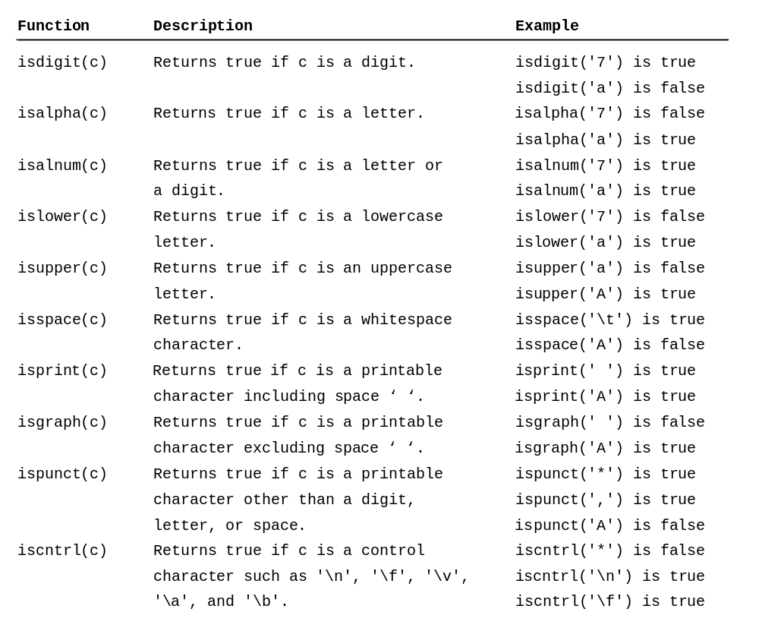
Character Test Functions

Slide 17
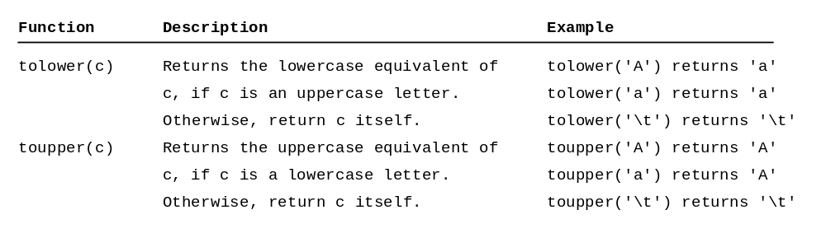
Case Conversion Functions
CharacterFunctions

Slide 18
Storing and Accessing Strings
A pointer-based string in C++ is an array of characters ending in the null terminator ('\0'), which indicates where a string terminates in memory. An array can be accessed via a pointer. So a string can also be accessed via a pointer, which points to the first character in the string. So you can declare a string variable using an array or a pointer. For example, the following two declarations are both fine:
char city[7] = "Dallas"; // Option 1
char *pCity = "Dallas"; // Option 2

Slide 19
Pointer Syntax
You can access city or pCity using the array syntax or pointer syntax. For example,
cout << city[1] << endl;
cout << *(city + 1) << endl;
cout << pCity[1] << endl;
cout << *(pCity + 1) << endl;
each displays character a (the second element in the string).

Slide 20
Reading Strings
You can read a string from the keyboard using the cin object. For example, see the following code:
cout << "Enter a city: ";
cin >> city; // read to array city
cout << "You entered " << city << endl;

Slide 21
Reading Strings Using getline
C++ provides the cin.getline function in the iostream header file, which reads a string into an array. The syntax of the function is:
cin.getline(char array[], int size, char delimitChar)
The function stops reading characters when the delimiter character is encountered or when the size - 1 number of characters are read. The last character in the array is reserved for the null terminator ('\0'). If the delimiter is encountered, it is read, but not stored in the array. The third argument delimitChar has a default value ('\n').

Slide 22
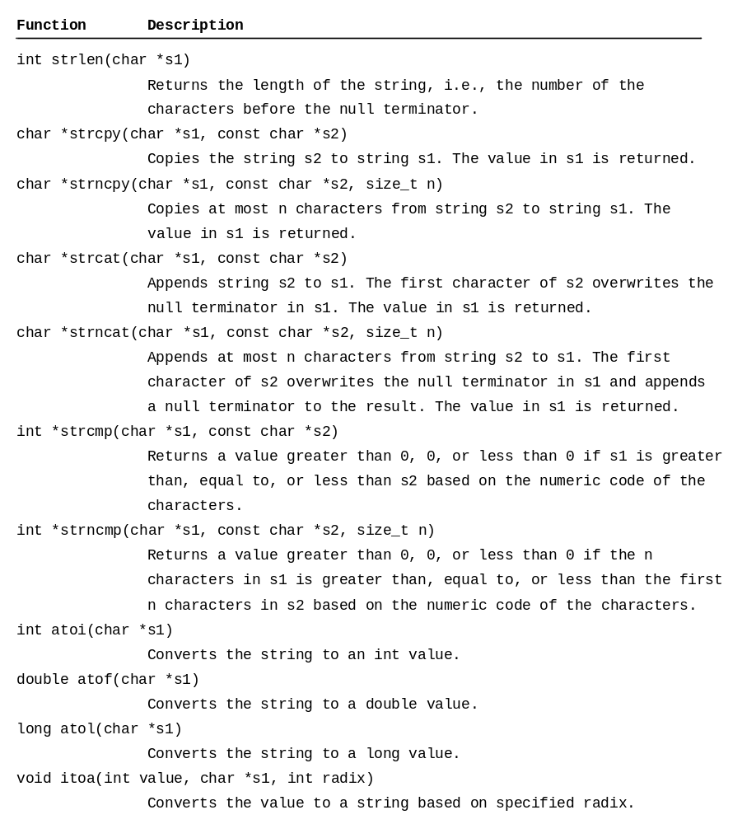
String Functions

Slide 23
String Examples
CopyString
CombineString
CompareString
StringConversion

Slide 24
Obtaining Substrings
Often it is useful to obtain a substring from a string. But there is no such function in C++. You can develop your own function for extracting substrings. The header of the function can be specified as:
char * substring(char *s, int start, int end)
Substring.h
TestSubstring

Slide 25
Checking Palindromes
A string is a palindrome if it reads the same forward and backward. The words “mom,” “dad,” and “noon,” for example, are all palindromes.
CheckPalindrome

Slide 26
Chapter Summary
Pointers are variables that store the memory address of other variables.
The declaration “int *pCount;” declares pCount to be a pointer that can point to an int variable.
The ampersand (&) symbol is called the address operator when placed in front of a variable. It is unary operator that returns the address of the variable.
Notes:
Circumvent 规避

Slide 27
Chapter Summary
A pointer variable is declared with a type such as int, double, etc. You have to assign the address of the variable of the same type.
Like a local variable, a local pointer is assigned an arbitrary value if you don’t initialize it. A pointer may be initialized to 0, which is a special value for a pointer to indicate the pointer points to nothing.
The asterisk (*) placed before a pointer is known as the indirection operator or dereference operator (dereference means indirect reference). When a pointer is dereferenced, the value at the address stored in the pointer is retrieved.
Notes:
Circumvent 规避

Slide 28
Chapter Summary
There are three types of pass arguments to a function in C++: pass-by-value, pass-by-reference with reference arguments and pass-by-reference with pointers.
An array variable without a bracket and a subscript actually represents the starting address of the array.
You can access array elements using pointers or index variables.
Notes:
Circumvent 规避

Slide 29
Chapter Summary
An integer may be added or subtracted from a pointer. The pointer is incremented or decremented by that integer times the size of the element to which the point points.
The const keyword can be used to declare a constant pointer and constant data.
A pointer may be returned from a function. But you should not return the address of a local variable from a function, because a local variable is destroyed after the function is returned.
Notes:
Circumvent 规避

Slide 30
Chapter Summary
The new operator can be used to allocate persistent memory on the heap. You should use the delete operator to release this memory, when it is no longer needed.
C++ provides useful functions for testing characters and converting letters: isdigit(c), isalpha(c), isalnum(c), islower(c), isupper(c), and isspace(c).
A string can be initialized using a string literal A null terminator character (‘\0’) is automatically inserted.
The cin.geline function can be used to read a string from the keyboard.
Notes:
Circumvent 规避

